Slide 1
Part 3: Trends in Fan System Engineering
Michael Ivanovich
Senior Director, AMCA International
mivanovich@amca.org
Malaysia AMCA, 5 December 2018

Slide 2
Agenda
1
Introducing the Fan Energy Index (FEI)
2
Variable Air Volume Design Tips
3
AMCA Standard 207
4
Using Evase´s on Exhaust Fans
5
Summary

Slide 3
Introducing Fan Energy Index (FEI)
Fan Energy Index is a revolutionary new fan-efficiency metric
Like FMEG in that it is wire-to-air = fan, motor, and drive
Unlike FMEG, it is an operating-point metric
NOT based on peak efficiency

Slide 4
Introducing Fan Energy Index (FEI)
FEI is defined in AMCA Standard 208 – Calculating Fan Energy Index
FEI is different for static-pressure (unducted) fans vs total-pressure (ducted) fans
Complex for manufacturers who rate fans
Much simpler than FEG and FMEG when applied by engineers
FEI developed in response to U.S. fan regulations that are yet to be completed

Slide 5
Elements of Fan Power
FMEG: Overall Fan Power (wire to air)
FEG:
Bare-Shaft Fan Power
(at the shaft)
Electrical Power In
Motor Loss (10%)
Drive Loss (3% -10%)
Bearing Loss (3%)
Aerodynamic Loss (10% to 20%)
Fan Power Out

Slide 6
Early Metric Attempts
Fan Efficiency Grade (FEG)
Based on peak fan total efficiency
Bare-shaft fan only; no motor, drive
ASHRAE 90.1, ASHRAE 189.1, IGCC, IECC, ISO 12759
“How good is the aerodynamic performance of the bare-shaft fan?”
Fan Motor Efficiency Grade (FMEG)
Based on peak overall fan efficiency (total or static)
Wire-to-air – fan, motor, and drive combination
ISO 12759, EU327
“How good is the motor-driven fan system?”

Slide 7
Regulatory Challenge
Typical practice is to select smaller-diameter fans for lowest first cost
Result is smaller, less-efficient fans that meet peak-efficiency requirements
ASHRAE 90.1 had provision for selecting fans within 15 percentage points of peak total efficiency
The sizing/selection window greatly complicates application and enforcement
Peak total pressure often not on nameplate
Total efficiency ratings usually not in manufacturer catalog data
How to calculate “peak total efficiency” from “actual total efficiency”?
Low-pressure fan types cannot be covered by FEG and sizing/selection window requirement
PRVs and panel fans are a LOT of fans left uncovered by ASHRAE 90.1

Slide 8
Efficiency Varies with Size for a Duty Point
Fan Size (mm) | Fan Speed (rpm) | Fan Power (kW) | Actual Total Efficiency (%) | FEG
460 | 3,238 | 8.8 | 40.1 | 85
510 | 2,561 | 7.2 | 49.5 | 85
560 | 1,983 | 6.0 | 59.0 | 85
610 | 1,579 | 5.0 | 69.1 | 85
685 | 1,289 | 4.6 | 75.8 | 85
770 | 1,033 | 4.3 | 82.5 | 85
920 | 778 | 4.5 | 78.7 | 85
This is why the 15- percentage point window needed

Slide 9
Introducing Fan Energy Index (FEI)
Designed to help “right size” fans
Moves selections to more efficient TYPES
Encourages optimizing motor and drive combinations
Covers low-pressure fans (Powered Roof Ventilators) and panel fans not covered by ASHRAE 90.1
Covers “external-rotor motor” fans with integrated motors and drives that are exempt from AMCA 205

Slide 10
Introducing FEI
FEI works to improve fan selections rather than remove “inefficient” fan models from the market
Manufacturers will strive to design fans with larger “high efficiency” operating points
Engineers will learn better design practice and have more flexibility to optimize fan systems for:
Efficiency
Acoustics
Cost
Size

Slide 11
FEI Calculated from Fan Test Data Using AMCA Standard 208
$$FEI= \frac{Selected Fan Efficiency}{Baseline Fan Efficiency}$$
$$FEI= \frac{Baseline Fan Electrical Input Power}{Selected Fan Electrical Input Power}$$
$$FEI= \frac{FEPref}{FEPactual}$$

Slide 12
Baseline Fan Shaft Input Power
$$H_{i,ref}=\frac{(Q_{i}+Q_{0})(P+P_{0}×\frac{ρ}{ρ_{std}})}{1000×η_{o}}$$
Q_{i} - selected fan airflow
P_{i} - selected fan total pressure (ducted), or tatic pressure (nonducted)
Ρ - air density
ρ_{std} - standard air density
Q₀ - 0.118 m3/s (SI), or 250 cfm (IP)
P₀ - 100 Pa (SI), or 0.40 in.wg (IP)
η₀ - 66% for ducted applications 60% for nonducted applications

Slide 13
Baseline Electrical Input Power
$$H_{i,ref}=\frac{(Q_{i}+Q_{0})(P+P_{0}×\frac{ρ}{ρ_{std}})}{1000×η_{o}}$$
W_{i,ref} = H_{i,ref} + AMCA 203 Belt Loss + IE3 Motor loss
W_{i,ref} = Baseline Electrical Input Power

Slide 14
Fan Energy Index Establishes “Selection Regions and Bubbles”
Selection regions and bubbles are portions of a fan curve that are compliant to a given FEI requirement
Designers size and select fans so that the nominal design point falls within the bubble
Manufacturers software will only show compliant selections for given operating conditions
The direct result is that few fan are models eliminated from market
Some shifting from less-efficient types to more-efficient types
Emphasis is on proper sizing and selection

Slide 15
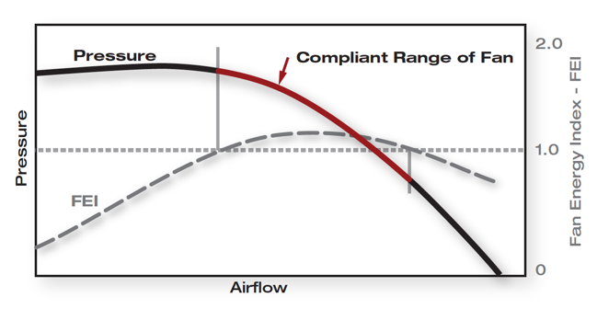
FEI Range for Constant Speed Fan

Slide 16
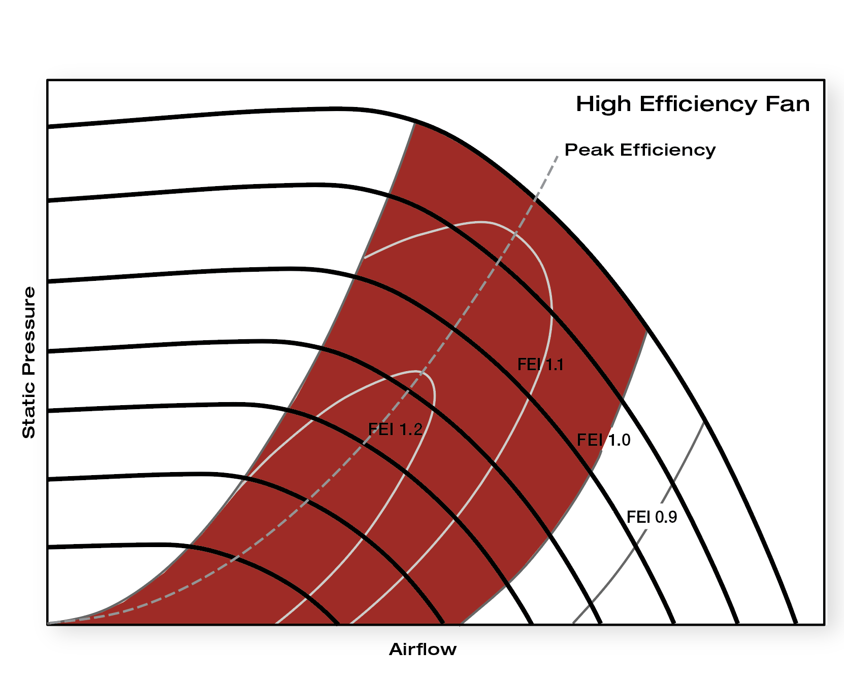
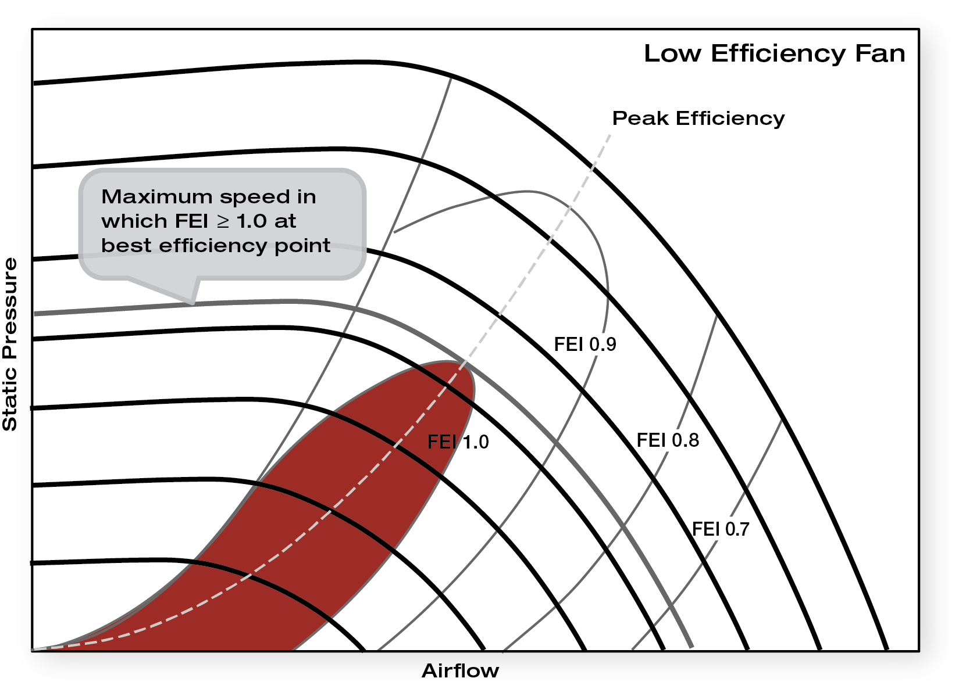
FEI Range for Centrifugal with Speed Control
EFFICIENT FAN
INEFFICIENT FAN

Slide 17
Regulating or Engineering Using FEI
Design Airflow and Pressure

Slide 18
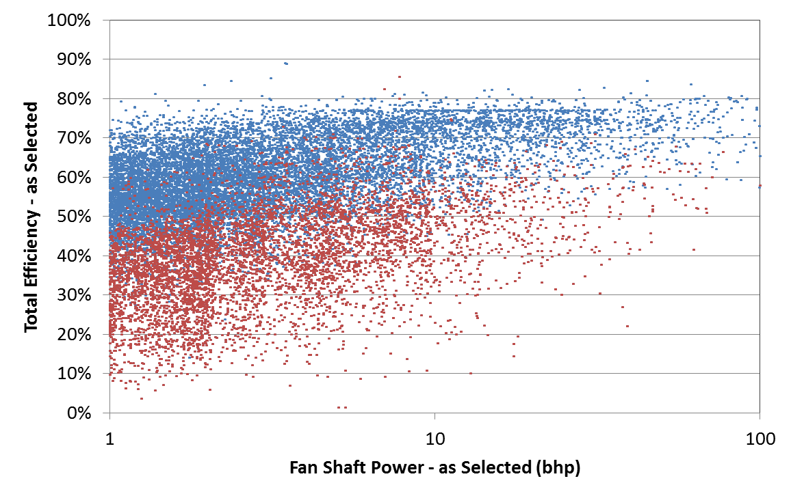
Noncompliant Fan Selections
45,000 fans
160,000 shaft kW
33% non-compliant
0.75
7.5
75
Fan Shaft Power (kW)

Slide 19
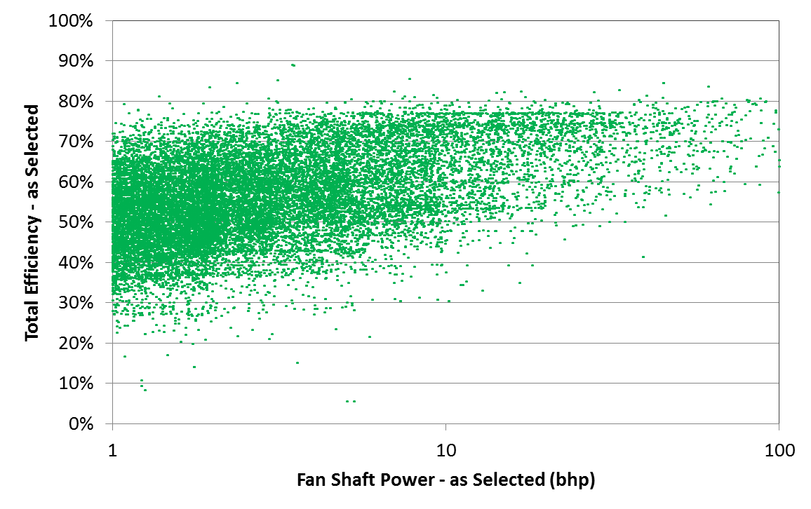
Revised Fan Selections
45,000 fans
160,000 shaft kW
10,300 kW saved (6%)
98% used same model
0.75
7.5
75
Fan Shaft Power (kW)

Slide 20
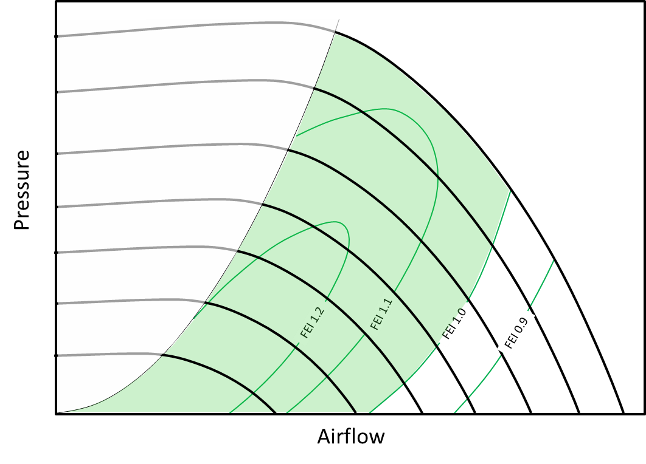
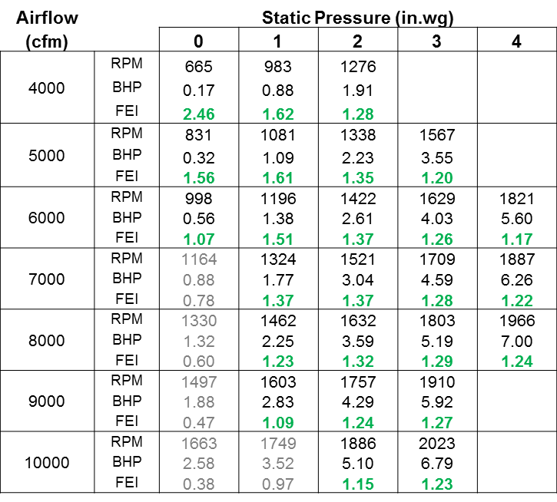
What FEI Will Look Like in Selection Tables
Green font = FEI > 1.0
Grey font = FEI < 1.0

Slide 21
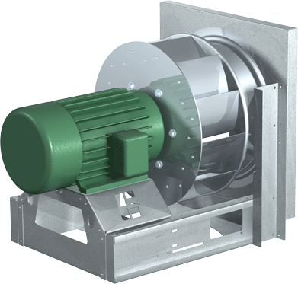
FEI Provides Visual Indication of Fan-System Efficiency
Multiple Speed Fan Performance Curves
“Relatively Hig-Efficiency Fan” – Large selection area
Pressure
Peak Efficiency
FEI 1.1
FEI 1.2
FEI 1.0
FEI 0.9
Airflow

Slide 22
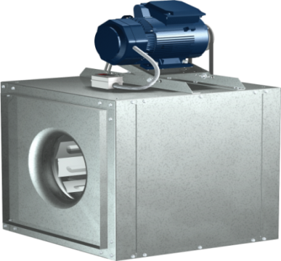
FEI Provides Visual Indication of Fan-System Efficiency
Multiple Speed Fan Performance Curves
“Relatively Low Efficiency Fan” – Small selection area
Pressure
Peak Efficiency
FEI 0.9
FEI 1.0
FEI 0.8
FEI 0.7
Airflow

Slide 23
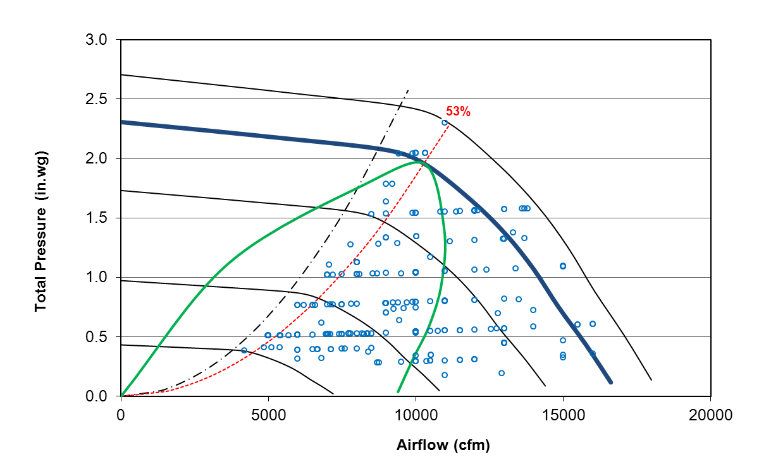
FEI for Same Fan Changes With Operating Point
Reduced max RPM eliminates
8% of fan selections and
15% of connected load
Total Pressure
Airflow

Slide 24
FEI Simpler to Enforce
Fan Size (mm) | Fan Speed (rpm) | Fan Power (kW) | Actual Total Efficiency (%) | Baseline Power | FEG | FEI
460 | 3,238 | 8.8 | 40.1 | 7.96 | 85 | 0.67
510 | 2,561 | 7.2 | 49.5 | 7.96 | 85 | 0.83
560 | 1,983 | 6.0 | 59.0 | 7.96 | 85 | 0.99
61 | 1,579 | 5.0 | 69.1 | 7.96 | 85 | 1.16
685 | 1,289 | 4.6 | 75.8 | 7.96 | 85 | 1.28
770 | 1,033 | 4.3 | 82.5 | 7.96 | 85 | 1.39
920 | 778 | 4.5 | 78.7 | 7.96 | 85 | 1.32
Regulation is FEI >= 1.0

Slide 25
FEI Can Be Used with Highly Configurable Variable-Pitch Axial Fans
Pressure
FEI 1.2
FEI 1.1
FEI 1.0
FEI 0.9
Airflow

Slide 26
Comparing FEI to FEG Fan Selections
Example: Un-ducted fans rated with static pressure
Shaft power (H_{ref} Table) from manufacturer software for sizing and selecting fans
Random-selected duty points (airflow and pressure)
Powered roof ventilators, three examples
Wall-mounted panel fans, three examples
All comparisons:
FEI = 1.0
FEG67+ 15 percentage points from peak total effic.
FEG67 no sizing/selection window
Apologies for “Inch-Pound” units due to available time

Slide 27
PRV 1:
Ps =1.00 in. WG
Airflow = 7000 cfm
PRV 2:
Ps =4.17 in. WG
Airflow = 7000 cfm
PRV 3:
Ps =1.93 in. WG
Airflow = 5000 cfm

Slide 28
PRV #1

Slide 29
PRV #2

Slide 30
PRV #3

Slide 31
Wall-Mounted Fan Comparison
Wall 1:
Ps =1.00 in. WG
Airflow = 7000 cfm
Wall 2:
Ps =4.17 in. WG
Airflow = 7000 cfm
Wall 3:
Ps =1.93 in. WG
Airflow = 5000 cfm

Slide 32
Wall Fan #1

Slide 33
Wall Fan #2

Slide 34
Wall Fan #2

Slide 35
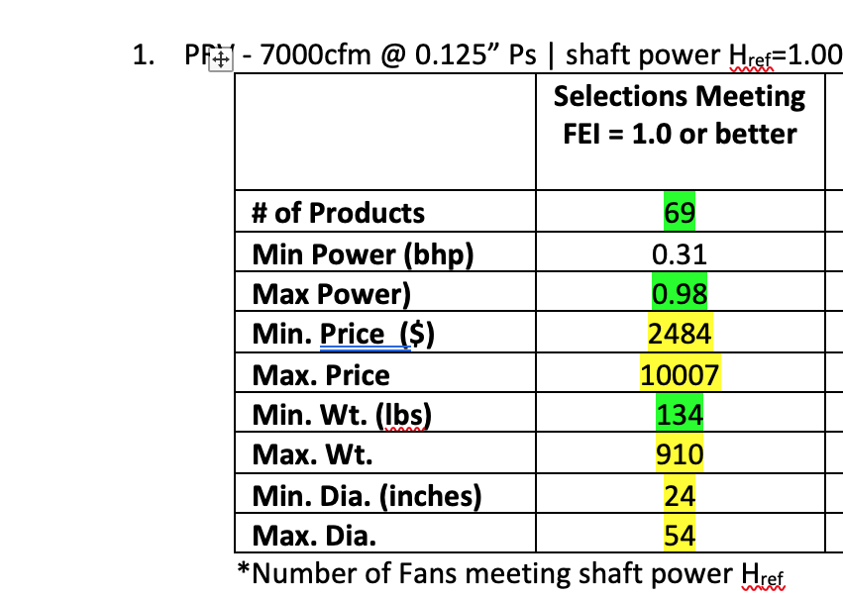
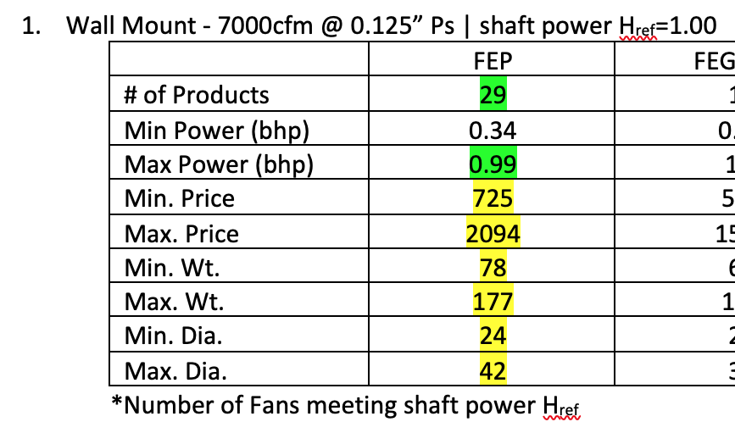
Compare Fan Types Using FEI Only
PRV 1 and Wall 1:
Ps =1.00 in. WG
Airflow = 7000 cfm
PRV#1
# Selections
Wall #1
# Selections

Slide 36
Status of FEI
FEI defined in AMCA 208-17
AMCA 208 being added to ISO 12759
FEI will replace FEG in ASHRAE 90.1-2019
FEI will gradually replace FEG in USA state energy codes
FEI proposed for California appliance regulation
Will likely be adopted for California Energy Code (similar to 90.1)

Slide 37
Status of FEI
FEI added to U.S. DOE Energy+ modeling software
FEI added to U.S. DOE Fan System Assessment Tool
FEI certification added to AMCA; no fans certified yet
AMCA members still need to add FEI to sizing/selection software
AMCA members need to publish FEI ratings in catalogs
No new testing required !
Complexity of adding motors and drives to FEI ratings is slowing progression

Slide 38
VAV Design Tips for Saving Energy
Presentations from Air Systems Engineering and Technology Conference (ASET)-United States, 2018 are online at no cost
Link to full PDFs of the PowerPoints
http://www.amca.org/news/ASET-US_Conference_Slides.php
Focus on:
Steve Taylor, PE, VAV Design Tips
Jeff Boldt, PE, Ensuring Fan-System Compliance with ASHRAE 90.1
Dan Int-Hout, Building Loads and Dedicated Outdoor Air Systems
John Sofra, Understanding and Reducing Air System Noise

Slide 39
Example: VAV Design Tips
Steve Taylor, PE:
http://bit.ly/2PYtKjF
Tip#1: Use Guideline 36 High Performance Sequences of Operation for HVAC Systems
This is the most important tip!
“Dual Max” control logic for VAV control
Trim & Respond Setpoint Reset control logic for VAV control
Mr. Taylor provides in-depth explanation of how these sequences work and save energy while not compromising indoor Air quality
Tip#2: Set VAV Box minimum airflow to minimum ventilation rate
Recent fix to Multiple Space Equation in Standard 62 make this simple
Previously the Multiple Space Equation was unsolvable, making difficult for multi-zone VAV control to prove 62.1 compliance

Slide 40
VAV Design Tips
Steve Taylor, PE:
http://bit.ly/2PYtKjF
Tip#3: Use Fan Arrays
No downside, allows very large air handling units
Tip#4: Control minimum outdoor air using differential pressure (DP) across fixed orifice
Finally a decent air flow management system (AFMS)

Slide 41
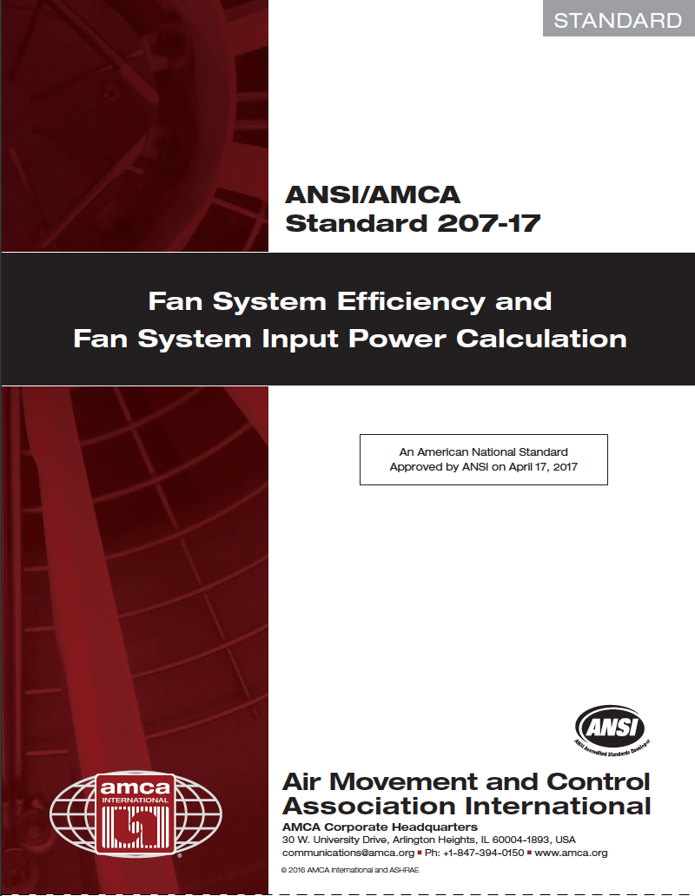
Other Trends in Fan-System Engineering
Application of AMCA Standard 207 for part-load motor, drive efficiency calculations
Emerging focus on exhaust-fan outlet design to include exit duct and evasé
New – AMCA white paper showing return-on-investment in progress
New construction and retrofit

Slide 42
Other Air-System Design Trends
AMCA Standard 207 Fan System Efficiency and Fan System Input Power Calculation
Estimate the input power and overall efficiency of an extended fan system (fan with motor, motor/drive)
Compare alternative fan system configurations in a consistent and uniform manner.

Slide 43
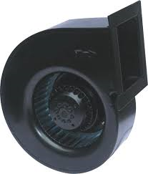
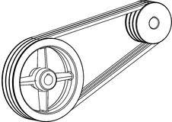
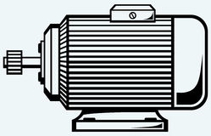
Other Air-System Design Trends
+
AMCA 207 covers fan-systems with:
Pulse-width modulated VFDs
Mechanical power transmissions that use V-belts, synchronous belts, or flexible couplings.
Polyphase induction motors within the scope of EPCA, IEC 60034-30-1, or GB 18613
+

Slide 44
AMCA 207 – Part-Load Motor/Drive Calculations
Calculate actual fan electrical input power (FEP_{act}) using fan test data and modeled motor, drive losses
Fan Electrical Input Power is the sum of all losses in motor-driven fan
FEP_{act} = Shaft to air + transmission loss + coupling loss + motor loss + VFD loss
Description and example calculations in ASET-US 2018 conference presentation by Trinity Persful, Twin City Fan at:
http://bit.ly/2P4flxb

Slide 45
Summary: FEI and Other Trends
Fan Energy Index is a new metric for fan efficiency
Wire to Air --- applies to fan + motor + drive
Has many benefits over FEG and FMEG
Covers low-pressure fans
No sizing/selection window
More flexibility to designers for motor and drive combinations, and fan types and sizes
Provides direct indication of fan system efficiency for return-on-investment analysis
Can improve acoustics

Slide 46
Summary
AMCA Air System Engineering and Technology (ASET) conference provides useful and timely instructional presentations
VAV design tips
Applying AMCA 207 for part-load motor/drive calculations
Improving HVAC acoustics
Complying with ASHRAE 90.1 and 62.1
AMCA white paper coming soon on applying exit ducts and evases to roof-mounted exhausts
Reduces system effect at exhaust exit
Retrofit
New construction

Slide 47
Part 3 Questions?

