Slide 1
Part 2: Upcoming Changes to International Standards
Michael Ivanovich
Senior Director, AMCA International
mivanovich@amca.org
Malaysia ASHRAE, 5 December 2018

Slide 2
Agenda
1
ASHRAE Standard 90.1 (Model Energy Standards)
2
AMCA Standard 205 for FEG
3
Harmonization of AMCA and ISO Standards
4
ISO System Effect and AMCA 201
5
Summary

Slide 3
Model Energy Standards for Fans
ASHRAE 90.1
2013: Fan Efficiency Grade
2016: Fan Efficiency Grade
2019: Fan Energy Index
International Energy Conservation Code (IECC)
2015: Fan Efficiency Grade
2018: Fan Efficiency Grade
2019: Fan Energy Index is being proposed

Slide 4
Model Energy Standards for Fans
In USA, individual states usually adopt IECC in part or modified
ASHRAE 90.1 included with purchase of IECC
States can elect to follow either IECC or ASHRAE 90.1
Some states, such as California, create own energy code
California did not adopt FEG in its Title 24 State Energy Code
U.S. Department of Energy federal fan efficiency regulation has been halted by Trump Administration
California has initiated an FEI-based ”appliance” standard for fans
Currently based on FEI

Slide 5
ASHRAE 90.1 - Fans
Fan Energy Index (FEI) replaces Fan Efficiency Grade (FEG)
FEG 67 replaced with FEI 1.0 and FEI 0.95 (for VAV)
Lower fan threshold reduced from 5-HP (3.75 kW) to 1-HP (0.75 kW)
Low-pressure fans (power roof ventilators and panel fans) now covered
Fans with integrated fan/motor/drive now covered
Exempt from AMCA 205
NO sizing/selection window needed

Slide 6
ASHRAE 90.1 - Fans
What has not changed:
Intended for “stand alone” fans
Exemptions for embedded fans
Fans in packaged equipment rated with an installed fan
Exemptions for safety fans
Fan arrays are covered
Currently, this “addendum” (change) has undergone all reviews and is only awaiting final ASHRAE Standard approval

Slide 7
ASHRAE 90.1 – Air Curtains
Air curtains are allowed as alternative to vestibules in International Energy Conservation Code and ASHRAE Standard 189.1 (high performance buildings)
Proposed for ASHRAE 90.1 in 2018
Addendum in second public review and is undergoing final ballots
It is expected ASHRAE 90.1-2019

Slide 8
ASHRAE 90.1 – Air Curtains
Research on air-curtain effectiveness was conducted by Concordia University, Canada
Sponsored by AMCA International, Berner International, Mars Air
Research featured modeling using computational fluid dynamics (CFD) with experimental verification of the CFD results

Slide 9
ASHRAE 90.1 – Air Curtains
5.4.3.4.3 Vestibule envelope. The exterior envelope of conditioned vestibules shall comply with the requirements for a conditioned space. The interior and exterior envelope of unconditioned vestibules shall comply with the requirements for a semiheated space.
Exceptions to 5.4.3.4
… 9. Self-closing doors in buildings in Climate Zones 0, 3, and 4 that have an air curtain complying with Section 10.4.5.
10. Self-closing doors in buildings 15 stories or less in Climate Zones 5 thru 8 that have an air curtain complying with Section 10.4.5.

Slide 10
AMCA Standard 205 Updates
AMCA Standard 205 Energy Efficiency Classification for Fans defines Fan Energy Grade (FEG)
First published in 2010
Last revised in 2012
Next revision will be published in 2019
Latest changes are now in final balloting process

Slide 11
AMCA Standard 205 Updates
Changes to AMCA Standard 205 are:
Deleted circulating fans from the scope (AMCA Standard 230)
Changed “fan size” to “impeller diameter” throughout standard
Moved 15-percentage point sizing/selection window to “informational” appendix, instead of “normative” appendix (not mandatory)

Slide 12
Harmonizing AMCA and ISO Standards
ISO Jet Tunnel Fan testing standard is being updated
Changes in AMCA 205-2019 will be brought into ISO 12759
AMCA 207 for calculating part-load efficiencies of motors and drives will be a separate section of ISO 12759
AMCA 208 for calculating FEI will be a separate section of ISO 12759
ISO and AMCA combining resources for System Effect technical report
Will lead to revisions of AMCA Publication 201- Fans and Systems
Calculation of System Effect Factor

Slide 13
Harmonizing AMCA and ISO Standards
AMCA and ISO are international standards bodies
Many ISO standards started from AMCA standards
Some AMCA standards started from ISO standards
The industry would like to purchase only one set of standards
So, AMCA and ISO are working on harmonization

Slide 14
Comparable AMCA and ISO Standards
AMCA No. | ISO No. | First AMCA Year | First ISO Year | Abbreviated Titles
204 | 14694 | 1996 | 2003 | Fans - Balance and Vibration
205 | Section in 12759 | 2010 | 2010 | Fans - FEG (AMCA and iSO) and FMEG (ISO)
207 | Section in 12759 | 2017 |  | Fans - Part Load Motor and Drive Efficiency Calculation REVISION IN PROGRESS; nearly done
208 | Section in 12759 | 2017 |  | Fans - Calculating Fan Energy Index REVISION IN PROGRESS; early stages
210 | 5801 | 1923 | 1997 | Fans - Testing for Rating
211 | 13348 | 1970 | 2006 | Fans - Tolerances, methods of conversion and technical data presentation

Slide 15
Comparable AMCA and ISO Standards (continued)
AMCA No. | ISO No. | First AMCA Year | First ISO Year | Abbreviated Titles
220 | 27327-1 | 1982 | 2009 | Air Curtain Testing for Rating
240 | working | 1995 |  | Positive Pressure Ventilator Testing for Rating JUST STARTING ISO STANDARD DEVELOPMENT
250 | 13350 | 2001 | 1999 | Jet Tunnel Fan Testing for Rating REVISION IN PROGRESS; midway
300 | 13347-2 | 1962 | 2004 | Fans- Determination of fan sound power levels — Part 2: Reverberant room method
320 | 13347-4 | 2007 | 2004 | Fans -- Determination of fan sound power levels- Part 4: Sound intensity method

Slide 16
ISO – AMCA Standards Harmonization
ISO 12759 – Fans—Energy efficiency classification for fans
Using “sections” to integrate AMCA standards
ISO # | Title | Equiv. AMCA Std.
12759-1 | Fans – Efficiency classification for fans – Part 1: General requirements
12759-2 | Fans – Efficiency classification for fans – Part 2: Standard losses for drive components | AMCA 207
12759-3 | Fans – Efficiency classification for fans – Part 3: Fans without drives at maximum operating speed | AMCA 205
12759-4 | Fans – Efficiency classification for fans – Part 4: Driven fans at maximum operating speed
12759-5 | Fans – Efficiency classification for fans – Part 5: Jet fans
12759-6 | Fans – Efficiency classification for fans – Part 6: Calculation of the Fan Energy Index | AMCA 208

Slide 17
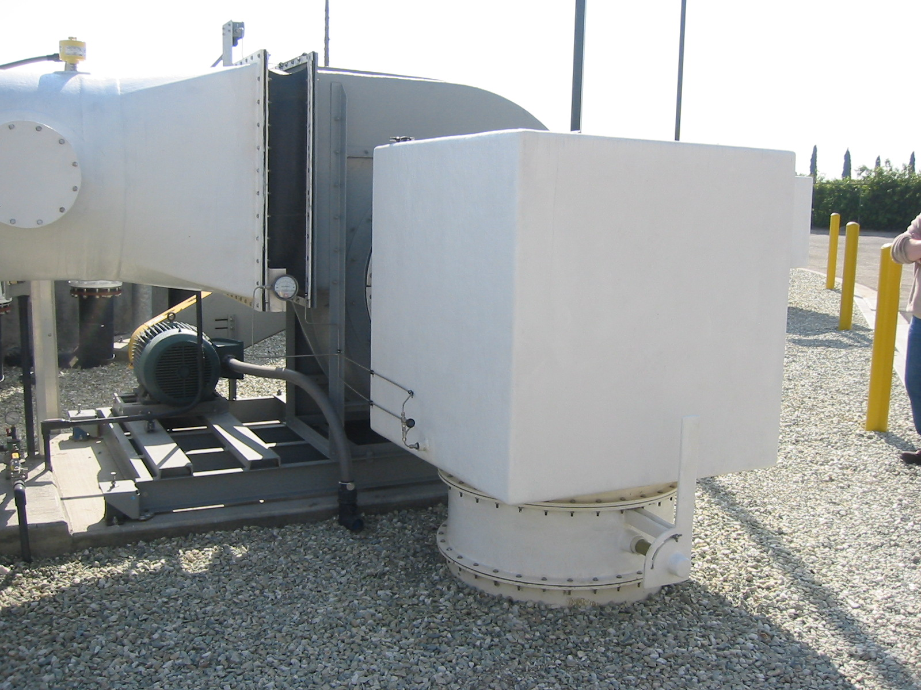
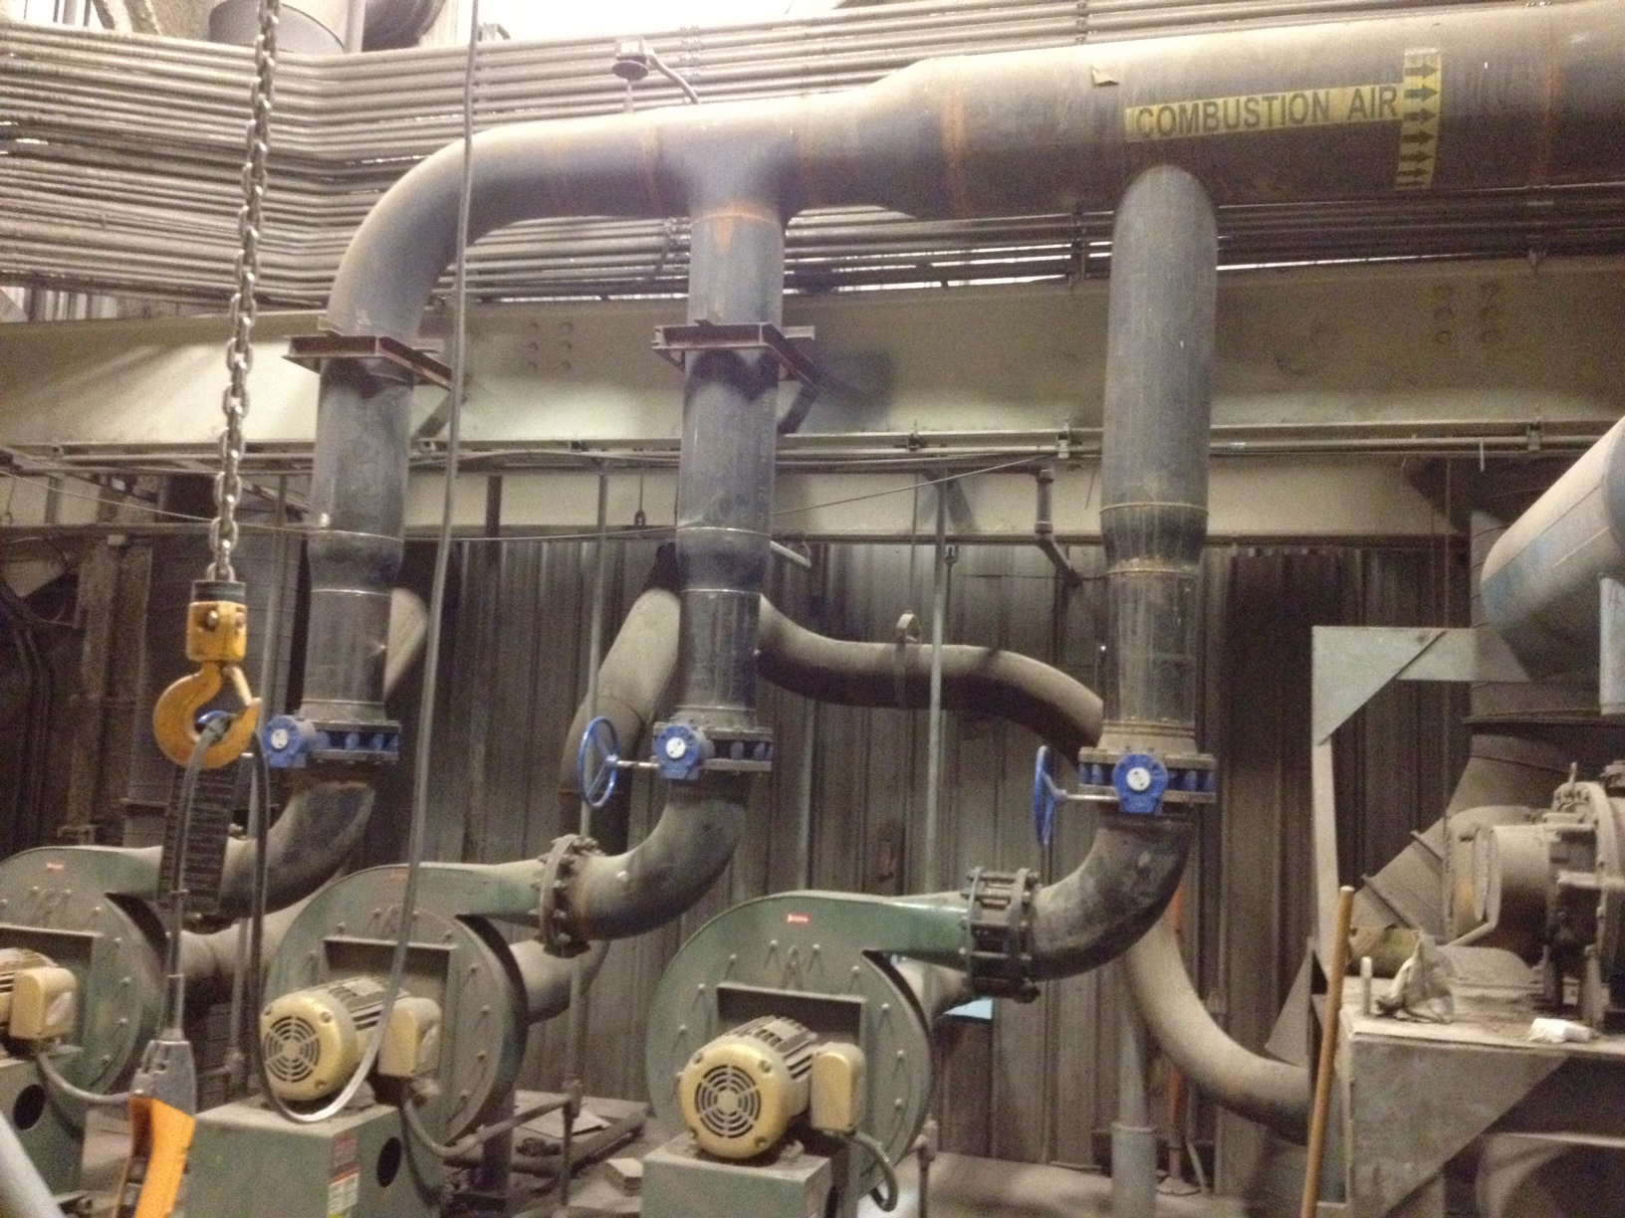
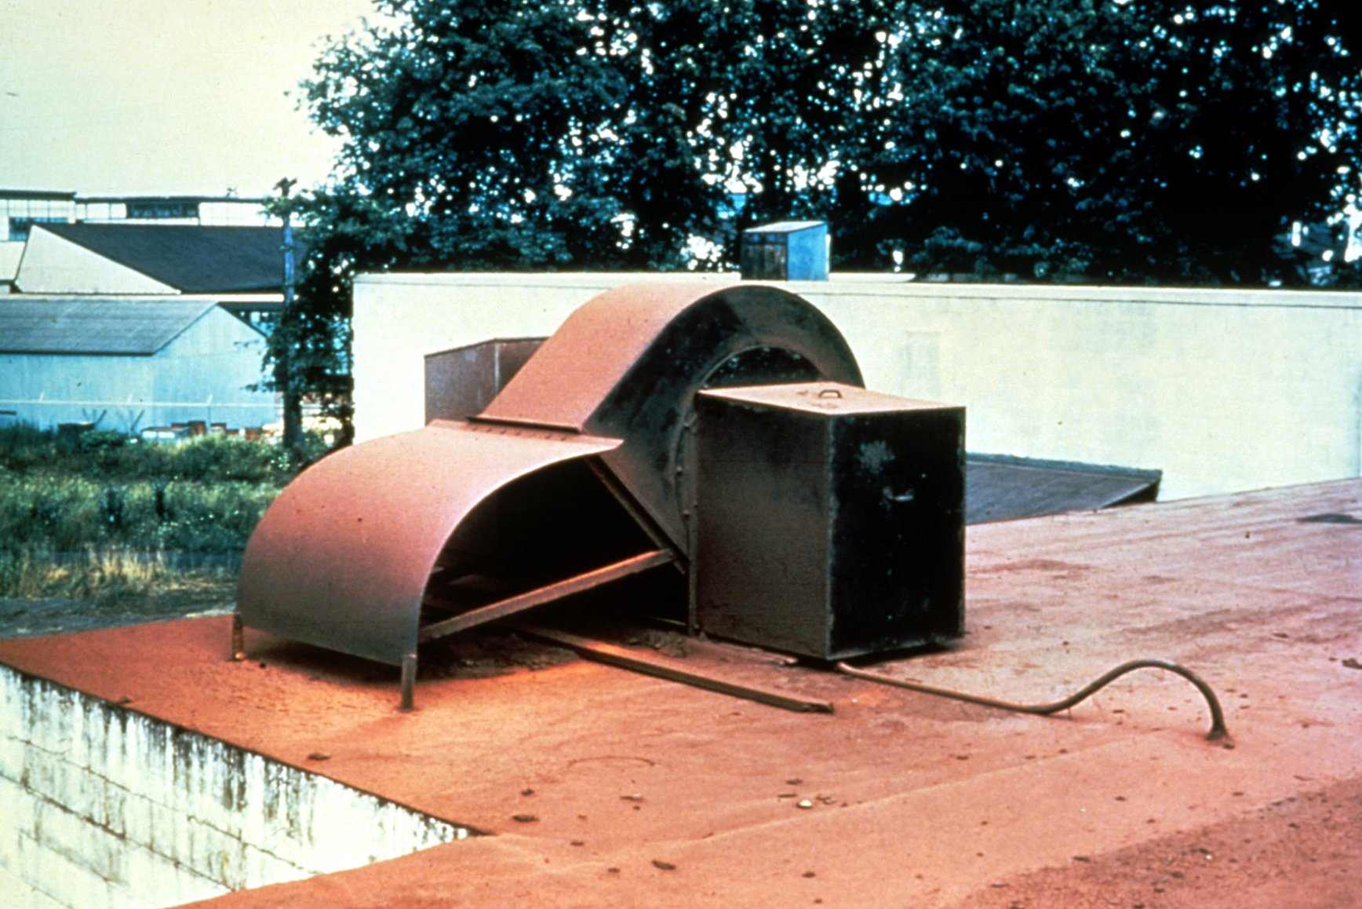
ISO – AMCA System Effect Research
Images courtesy of NY Blower Co.
Notes:
Fan applications are sub-sonic. That means that all flow/pressure information is, theoretically communicated in all directions up and downstream of the fan.

Slide 18
ISO – AMCA System Effect Research
Net LIFETIME impacts of system effect are:
Fan does not perform as rated (less airflow, pressure)
More energy is consumed
More noise is generated
Service life of fan can be reduced
Review of 20 years of research:
System Effect Factor (SEF) for fan inlet is different from outlet SEF
SEF-Outlet results in a pressure deficiency
Known and in reference materials
SEF-Inlet results in an airflow deficiency
Entirely new finding

Slide 19
ISO – AMCA System Effect Research
SEF-outlet is a pressure deficiency
SEF calculation method n AMCA 201-02(2011) Fans and Systems
www.amca.org/store

Slide 20
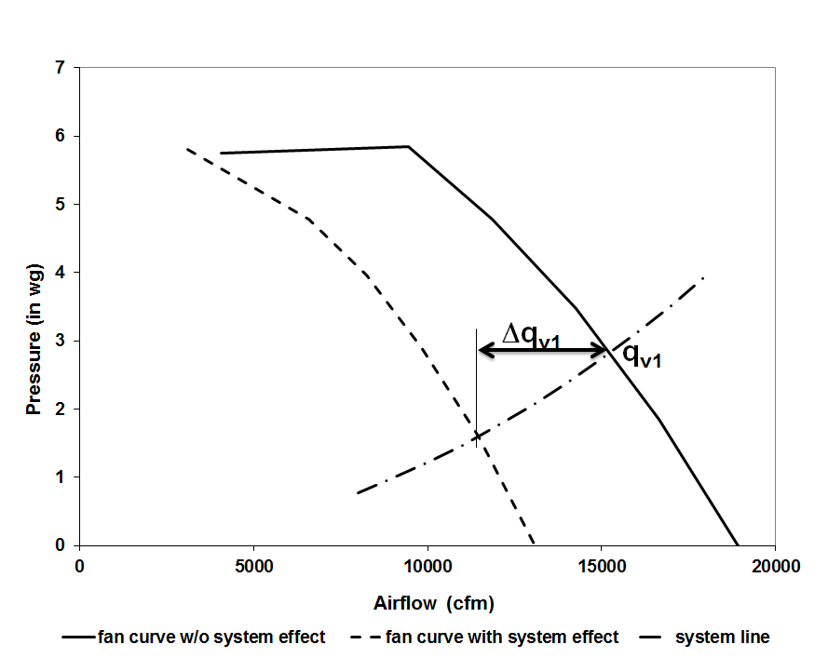
ISO – AMCA System Effect Research
SEF-inlet is an air flow deficiency
ISO Technical Report in progress:
ISO/WD TR 16219:201X, Fans -- System effects and system effect factors
Likely published in 2019
.

Slide 21
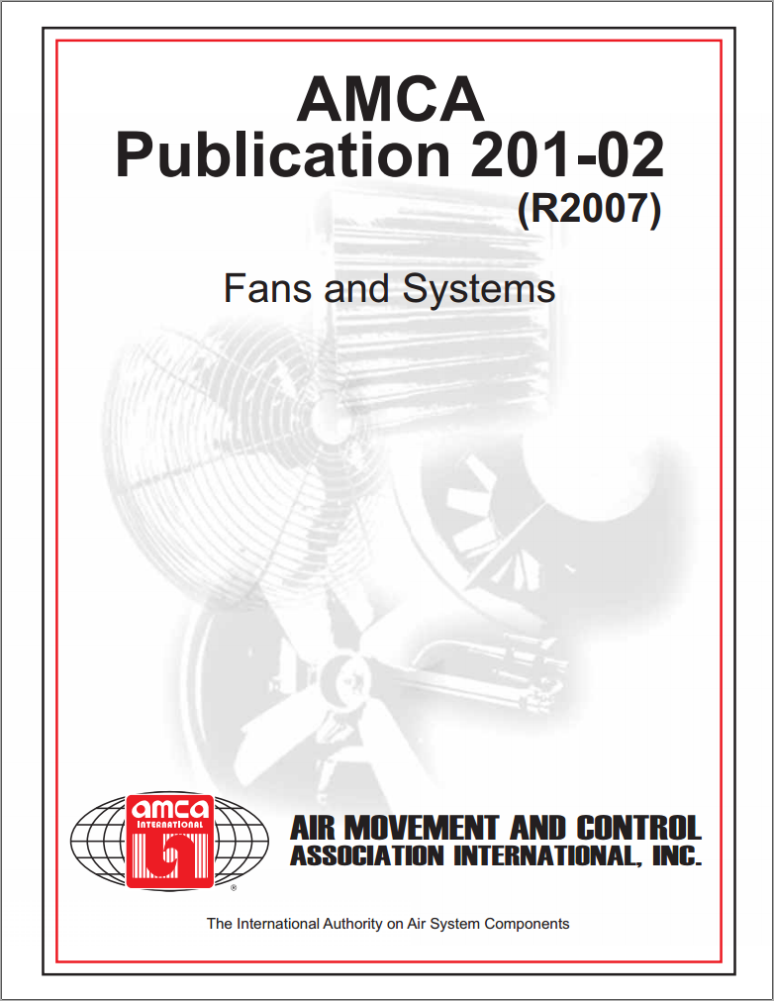
ISO – AMCA System Effect Research
ISO technical report will influence changes to AMCA 201-02(R201X)
Likely published in 2019
Changes will focus on calculating SEF for inlet and outlet

Slide 22
Summary: Standards Update
ASHRAE 90.1-2019
FEI will replace FEG, with substantial changes to scope in terms of fan size and inclusion of previously exempted fan types
Air curtains can be used as alternative to vestibules
ISO 12759 will incorporate AMCA FEI Standard 208
ISO 12759 will incorporate AMCA motor/drive calc. Standard 207
AMCA 205 for FEG rating will have some changes in early 2019
ISO standard for jet fans will be updated in 2019
Changes to AMCA 201 Fans and Systems will be modified per ISO/AMCA technical report on system effect research

Slide 23
Part 2 Questions?

